Slide 1
Dimension Reduction

Slide 2

Curse of Dimensionality
Identifying Moving objects by human
Find a coin in a line , in a 2d space , in 3d space
How to convert 3 dimensional object into 2 or 1 dimension
Converting ourselves in 2 or 1 dimensions
Copyright © www.ITbodhi.com
Notes:
The monitor probably contains a million pixels, and the
ball is represented by, say, a thousand pixels. In most sports, we’re concerned with
the position of the ball at a given time. For your brain to follow what’s going on,
you need to follow the position of the ball on the playing field. You do this naturally,
without even thinking about it. Behind the scene, you’re converting the million
pixels on the monitor into a three-dimensional image showing the ball’s
position on the playing field, in real time. You’ve reduced the data from one million
dimensions to three.
<number>

Slide 3
Pros and Cons
Pros
Making the dataset easier to use
Reducing computational cost of many algorithms
Removing noise
Making the results easier to understand
Data Visualization
Cons:
May not be needed, could throw away useful information
Works with: Numerical values [ problematic in categorical features ]
There are NO MISSING VALUE in dataset
Copyright © www.ITbodhi.com

Slide 4
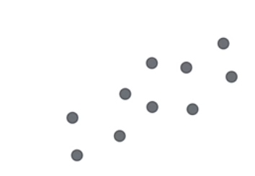
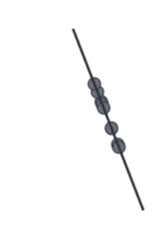
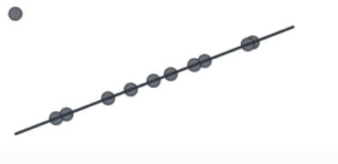
Dimension Reduction
Copyright © www.ITbodhi.com

Slide 5
Dimension Reduction which one
Copyright © www.ITbodhi.com

Slide 6
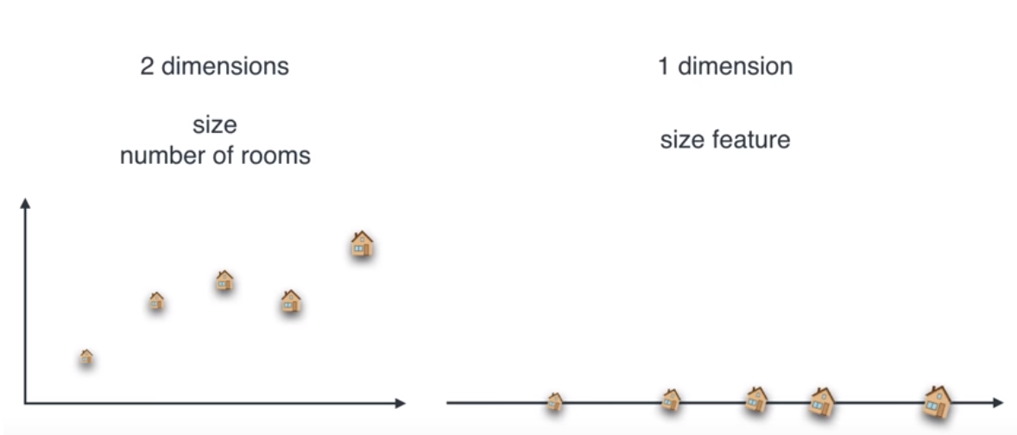
Dimension Reduction
Copyright © www.ITbodhi.com

Slide 7
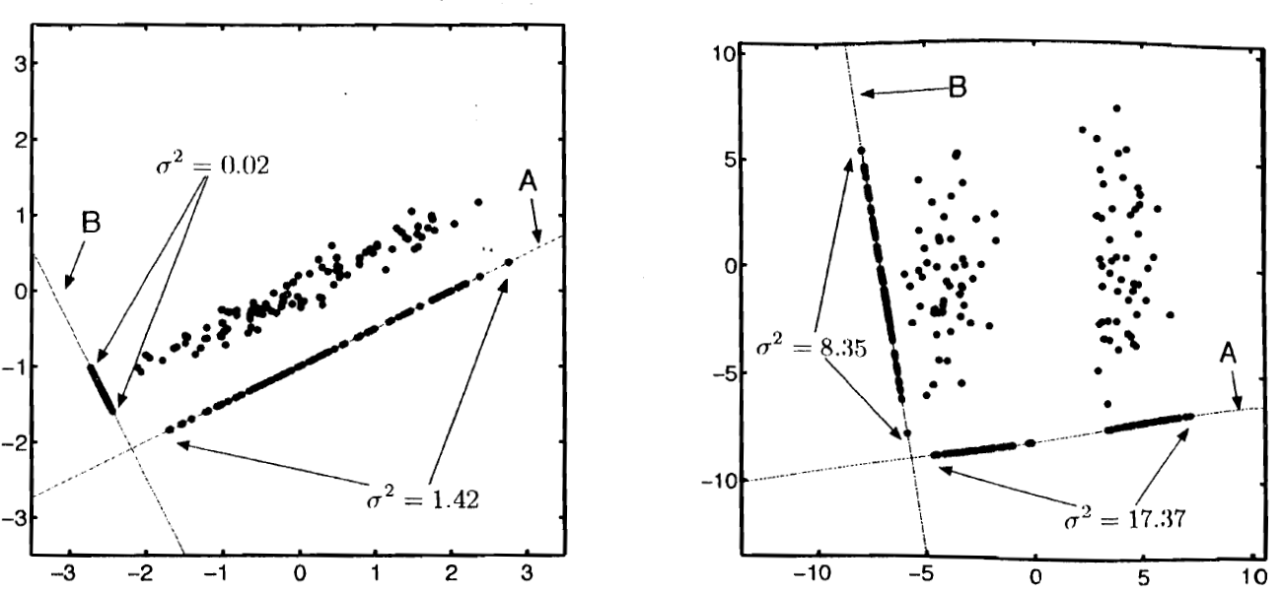
Dimension Reduction in Cluster
Copyright © www.ITbodhi.com

Slide 8
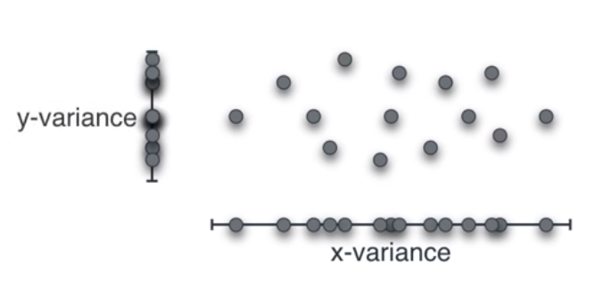
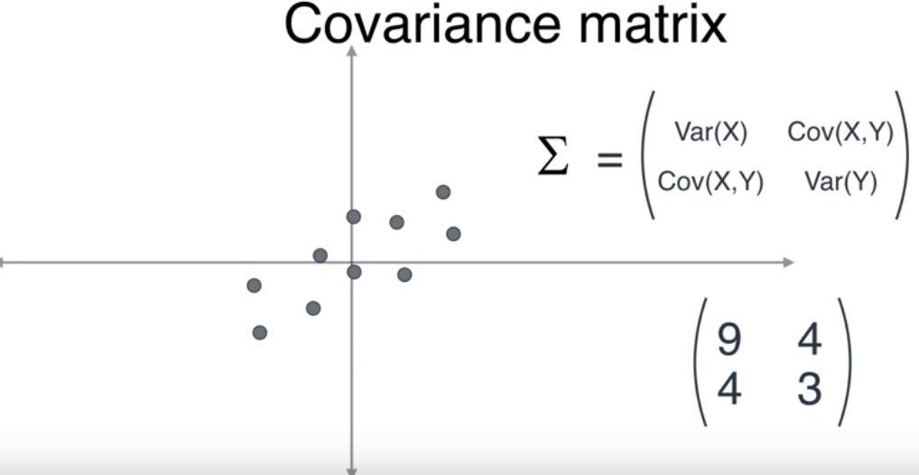
Dimension Reduction which one
Copyright © www.ITbodhi.com

Slide 9
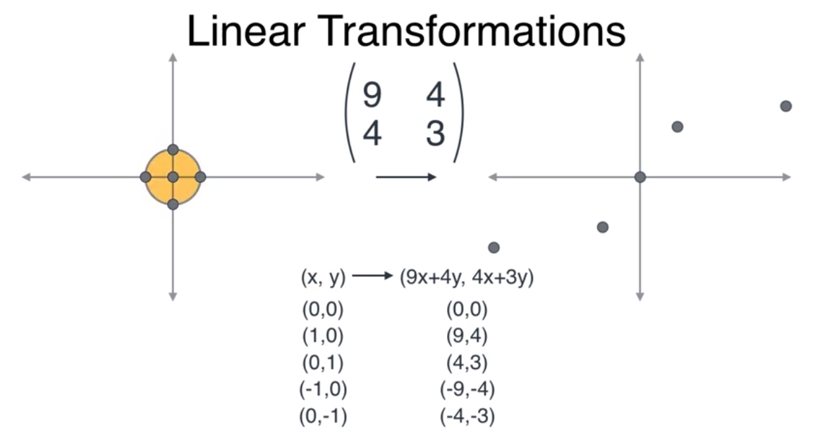
Linear Transformation
Copyright © www.ITbodhi.com

Slide 10
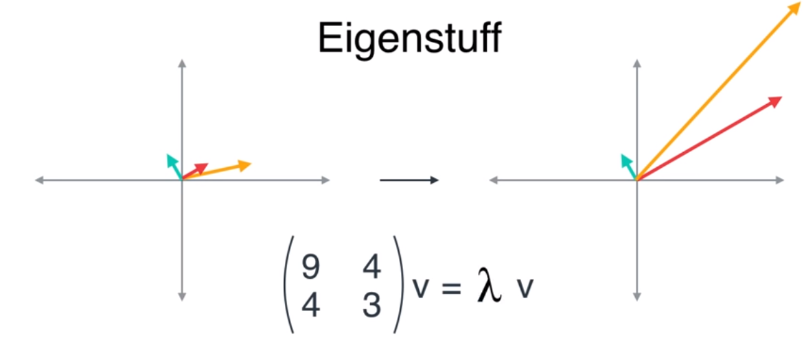
Eigen vector and Eigen Values
Copyright © www.ITbodhi.com

Slide 11
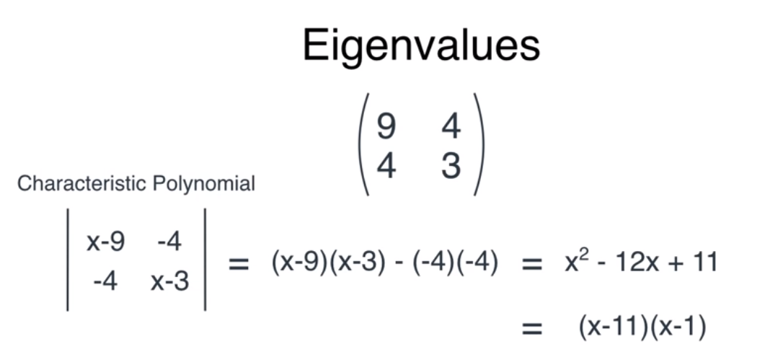
Eigen Value Calculation
Copyright © www.ITbodhi.com

Slide 12
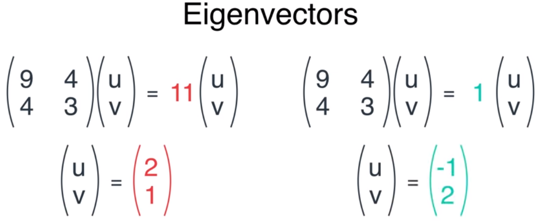
Eigen Vector Calculation
Copyright © www.ITbodhi.com

Slide 13
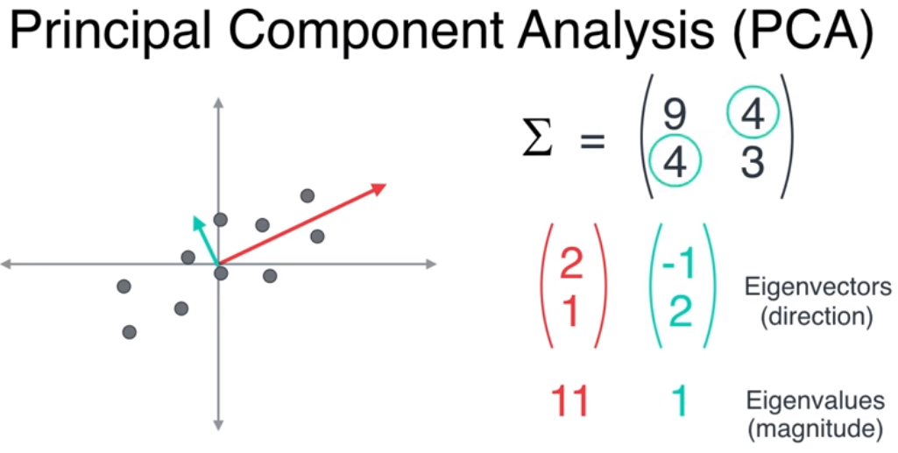
Eigen Vector Calculation
Copyright © www.ITbodhi.com

Slide 14
Eigen vector tell us about dataset that data is stretched in which direction and by how much.
Copyright © www.ITbodhi.com

Slide 15
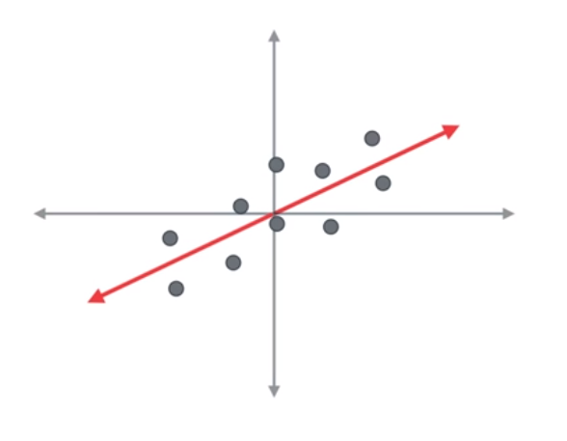
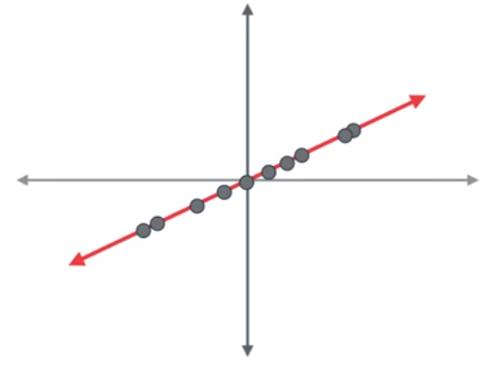
Selecting projection line
Copyright © www.ITbodhi.com

Slide 16
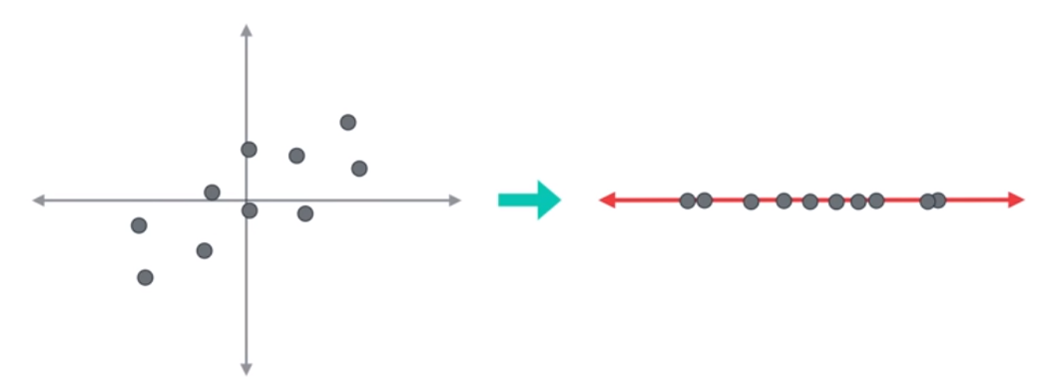
We found it …
Copyright © www.ITbodhi.com

Slide 17
We found it …
Copyright © www.ITbodhi.com

Slide 18
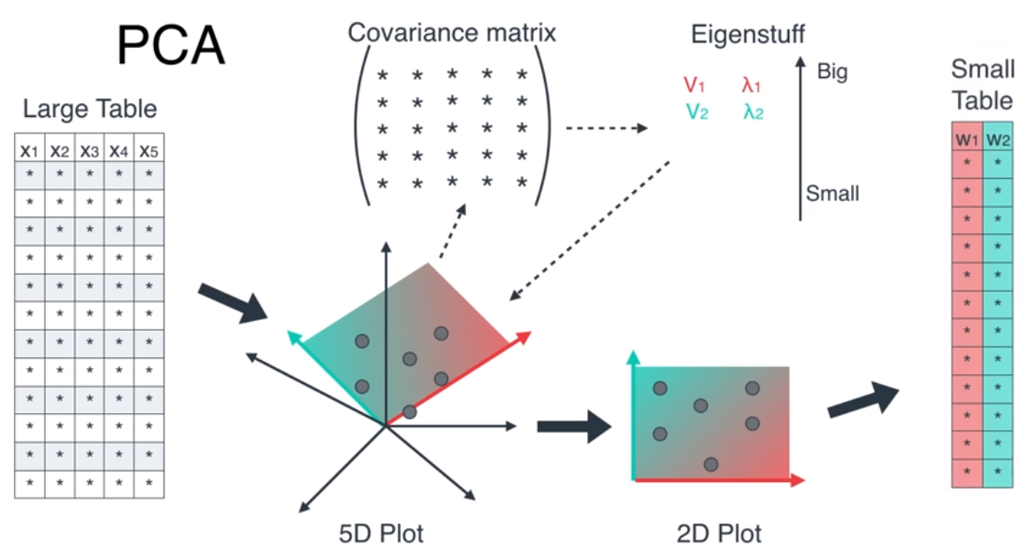
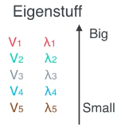
We found it …
4
3
5
1
Discard
bottom 3
2
7
6
Copyright © www.ITbodhi.com

Slide 19
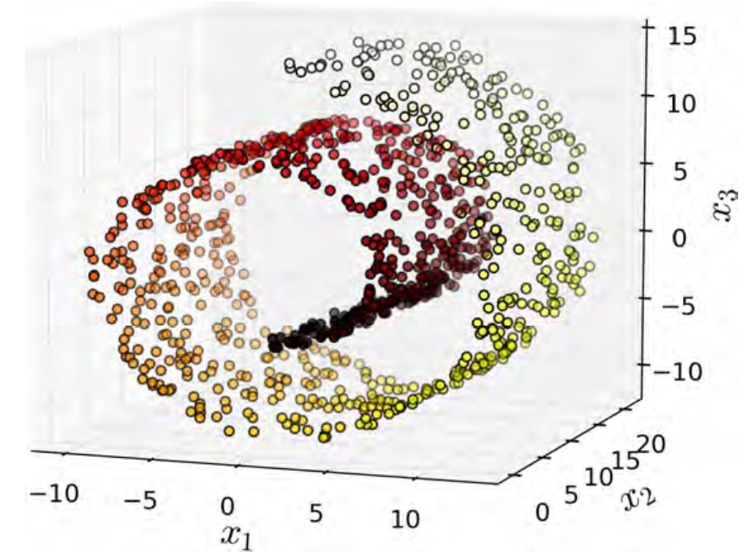
Swiss roll
Copyright © www.ITbodhi.com

Slide 20
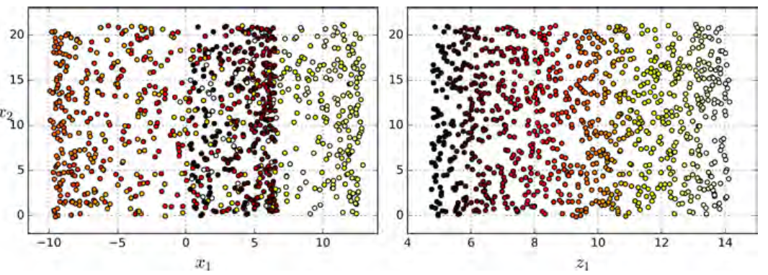
Swiss roll - Projection
Projection
Unrolling
Copyright © www.ITbodhi.com

Slide 21
Swiss roll - Projection
Projection
Unrolling
Copyright © www.ITbodhi.com

Slide 22
Manifold Learning
The Swiss roll is an example of a 2D manifold.
Put simply, a 2D manifold is a 2D shape that can be bent and twisted in a higher-dimensional space.
More generally, a d-dimensional manifold is a part of an n-dimensional space
(where d < n) that locally resembles a d-dimensional hyperplane.
In the case of the Swiss roll, d = 2 and n = 3:
It locally resembles a 2D plane, but it is rolled in the third dimension
Copyright © www.ITbodhi.com

Slide 23
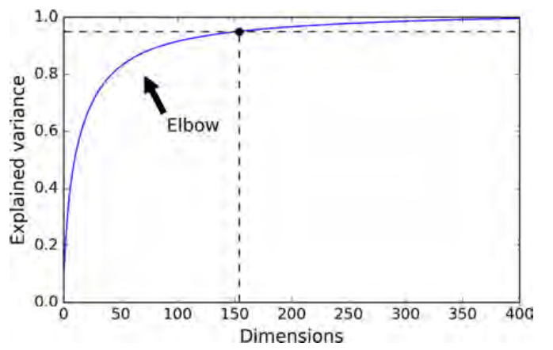
Choosing Right # of Dimensions
Copyright © www.ITbodhi.com

Slide 24
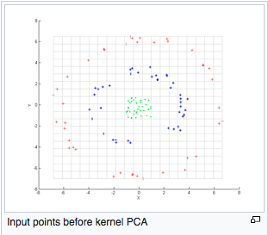
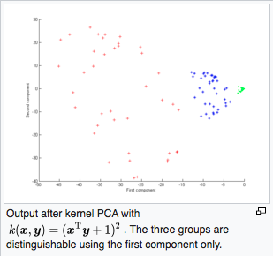
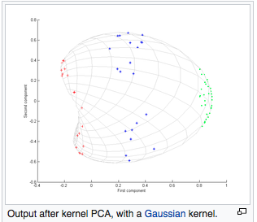
Kernel PCA

Slide 25
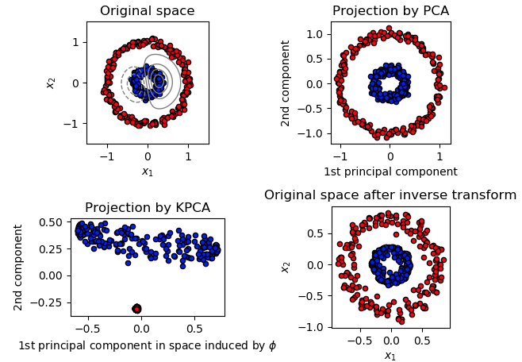
Kernel PCA

Slide 26
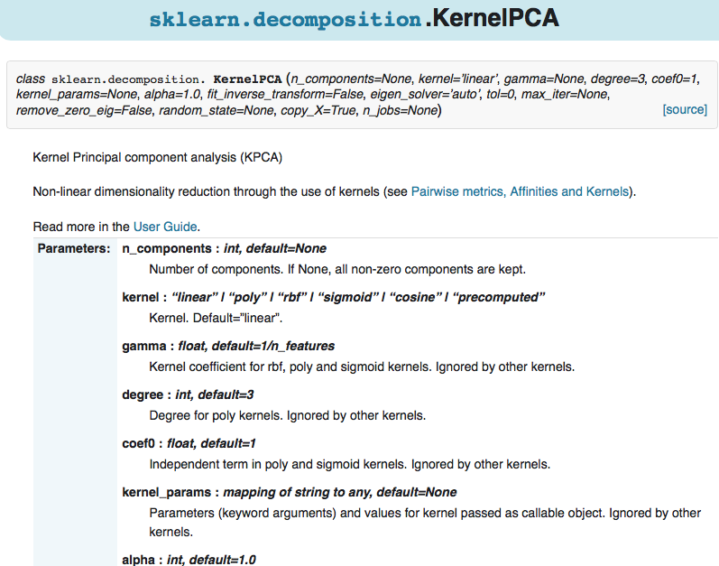
Kernel PCA

Slide 27
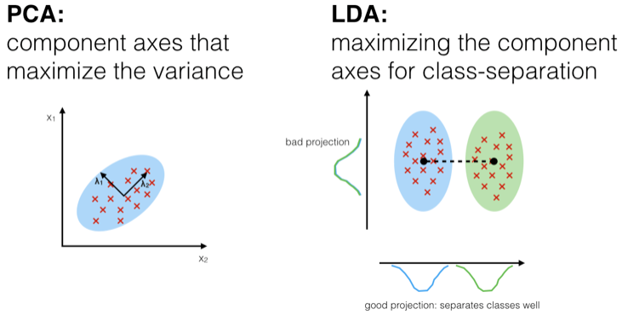
Linear Discriminant Analysis
LDA (Linear Discriminant Analysis):
Projects data in a way that the class separability is maximised. Examples from same class are put closely together by the projection. Examples from different classes are placed far apart by the projection

Slide 28
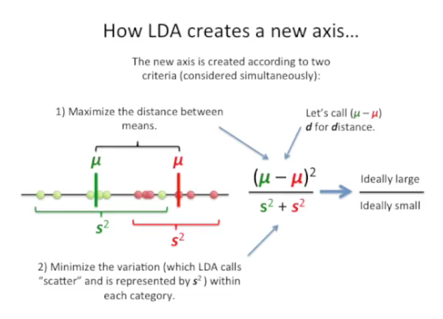
How LDA works

Slide 29
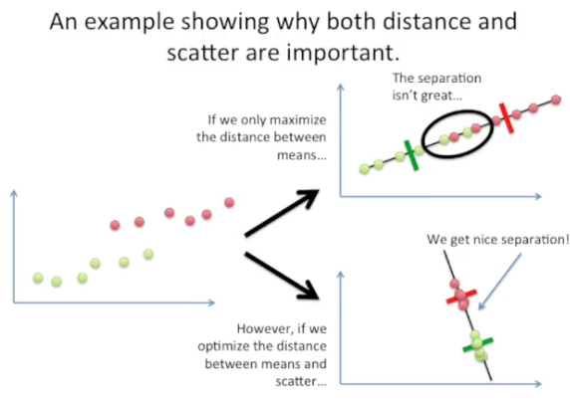

Slide 30
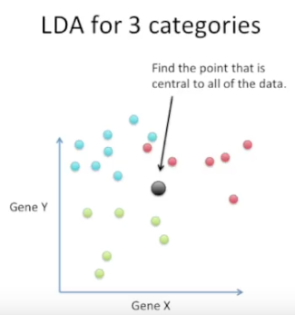
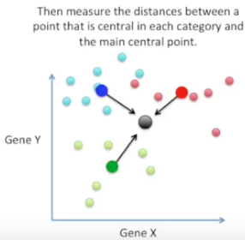
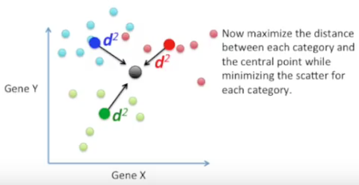
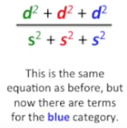
With 3 categories

